Slide 1
Unibuddy

Slide 2

Unibuddy
It’s all about making new friends

Slide 3
Unibuddy
Scared about starting university and making new friends?
Well, stop worrying and start downloading an app called ‘Unibuddy’ – solution to your worries.

Slide 4
Unibuddy
Imagine making new friends and getting to know people before you even start university…

Slide 5
Unibuddy
Don’t know how to start a conversation?
You can choose from a list of given topics..
- Always there to make your life easy.

Slide 6
What makes our app different?
Helps people make new friends.
Talk to people with similar interests.

Slide 7
Business Innovation
App is not only for profit purposes it serves to the community and those who face social anxiety
Involves local businesses
Targeted marketing
Niche
Unique app, with unique marketing strategy for businesses and us
Consistent demand
App can help in other fields – Social anxiety, student welfare.

Slide 8
Innovative Mobile App
We used firebase , explored new technology
Filling gap in the market
Matching algorithm

Slide 9
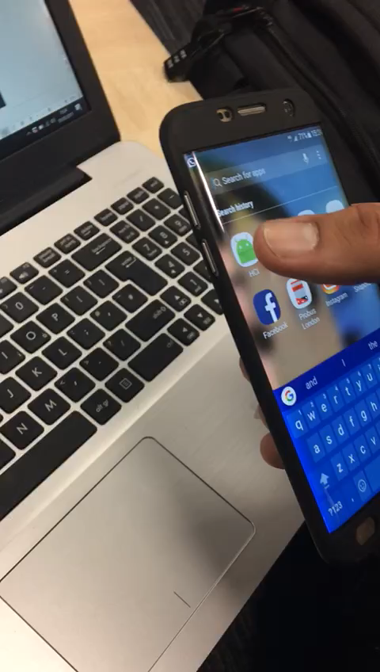
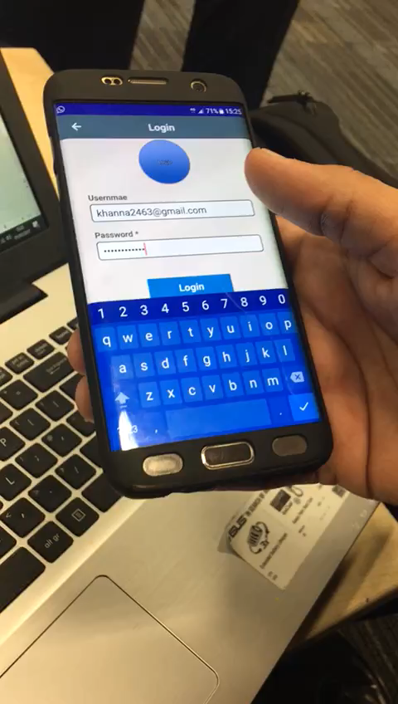

Slide 10
Create events
Group chats
User content
Allow user generated content
No middleman
Allow for sudden plans
Broadcast messages
Stay after uni?
Only for uni
Meet ups
Easy to replicate model
Global buddy
Categorise students by couse , i.e masters. PG UG
Versatile App
Intergrate TT

